Slide 1
VGW Predicting Wine Quality and Pricing at Market
Vera Lake
D214 – Task 3

Slide 2
agenda
Introduction
Statement of the problem and the hypothesis
Summary of the data-analysis process
Outline of the findings
Limitations of the techniques and tools used
Summary of proposed actions
Expected benefits of the study

Slide 3
Introduction

Slide 4
Problem and hypothesis statement
PROBLEM
Very Good Wine LLC is looking to predict the quality of their wine to make
better decisions on how to price their wine.
Can the quality of wine be accurately predicted for three categories
of poor, average, and excellent?
HYPOTHESIS
Physiochemical properties statistically significantly affects the quality
category of Very Good Wine LLC’s wine.

Slide 5
Summary of data-analysis process

Slide 6
Explore the data
Data Dictionary Input variables (based on physicochemical tests):
fixed acidity
most acids involved with wine or fixed or nonvolatile (do not evaporate readily)mg/L)
volatile acidity
the amount of acetic acid in wine, which at too high of levels can lead to an unpleasant, vinegar taste
U.S. legal limits of Volatile Acidity: Red Table Wine 1.2 g/L
citric acid
found in small quantities, citric acid can add 'freshness' and flavor to wines
citric acid is found only in very minute quantities in wine grapes
residual sugar
the amount of sugar remaining after fermentation stops, it's rare to find wines with less than 1 gram/liter and wines with greater than 45 grams/liter are considered sweet

Slide 7
Explore the data
Data Dictionary Input variables (based on physicochemical tests):
5. chlorides
the amount of salt in the wine
6. free sulfur dioxide
the free form of SO2 exists in equilibrium between molecular SO2 (as a dissolved gas) and bisulfite ion; it prevents microbial growth and the oxidation of wine
7. total sulfur dioxide
amount of free and bound forms of S02; in low concentrations, SO2 is mostly undetectable in wine, but at free SO2 concentrations over 50 ppm, SO2 becomes evident in the nose and taste of wine
8. density
the density of water is close to that of water depending on the percent alcohol and sugar content
9. pH
describes how acidic or basic a wine is on a scale from 0 (very acidic) to 14 (very basic); most wines are between 3-4 on the pH scale
makes wine taste softer

Slide 8
Explore the data
Data Dictionary Input variables (based on physicochemical tests):
10. sulphates
a wine additive which can contribute to sulfur dioxide gas (S02) levels, wich acts as an antimicrobial and antioxidant
11. alcohol
the percentage of alcohol present in the wine

Slide 9
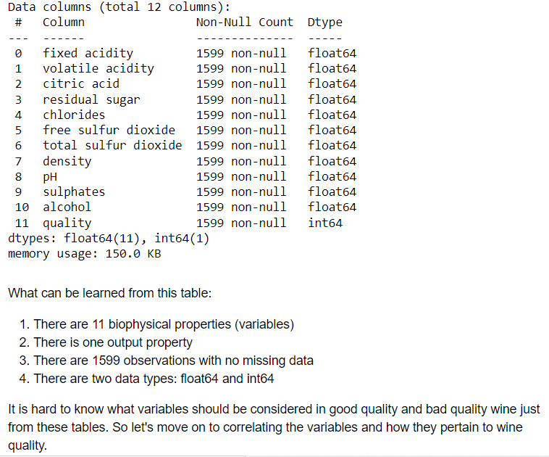
Explore the data

Slide 10
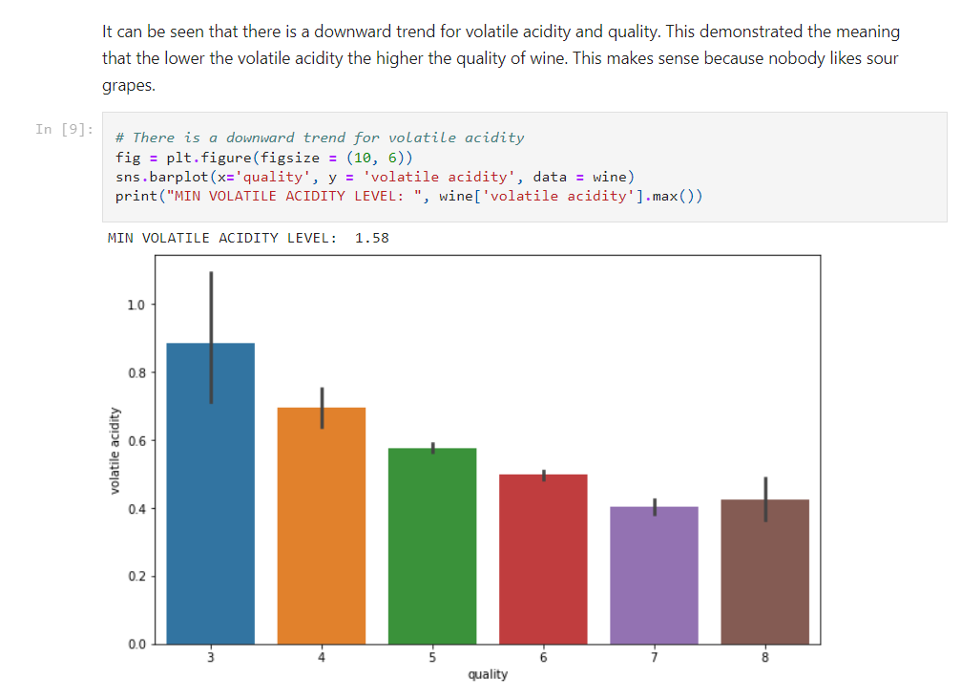
Explore the data

Slide 11
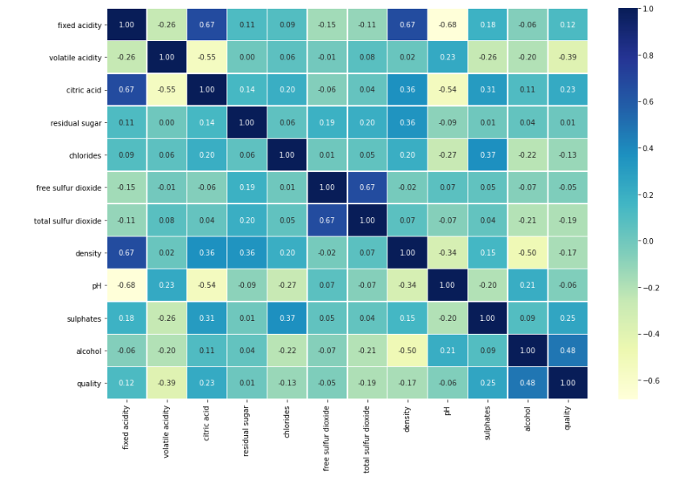
Explore the data
A correlation heat map is a descriptive method that was used to analyze the data was a correlation heatmap between the physiochemical input features and the output quality feature. This heat map had the intent of helping the end user visualize which features were more strongly correlated with the quality rating (and other features if they would be interested in that). This gives an idea of which features would be more important to the predictive model that the others.
The correlation heat map was a great visualization for an overall view of each feature's correlation to quality and all the other features if a stakeholder or data team member is interested in that.

Slide 12
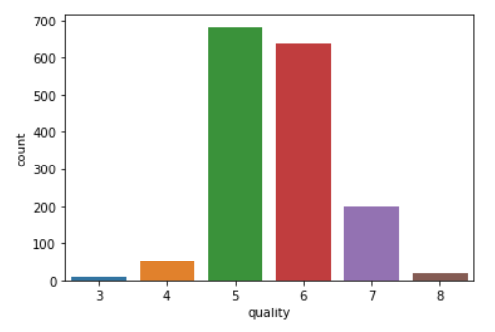
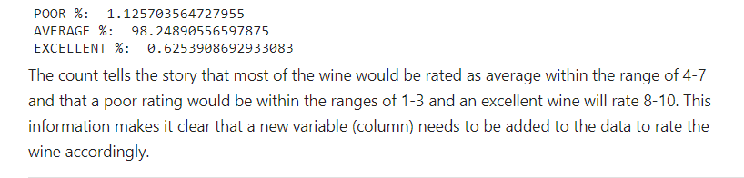
Explore the data
The count tells the story that most of the wine would be rated as average within the range of 4-7 and that a poor rating would be within the ranges of 1-3 and an excellent wine will rate 8-10. This information makes it clear that a new variable (column) needs to be added to the data to rate the wine accordingly.

Slide 13
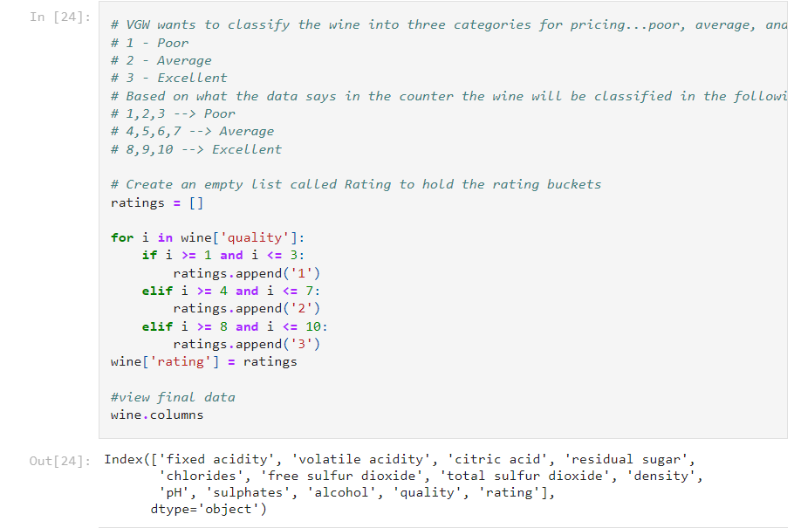
Add a quality rating label

Slide 14
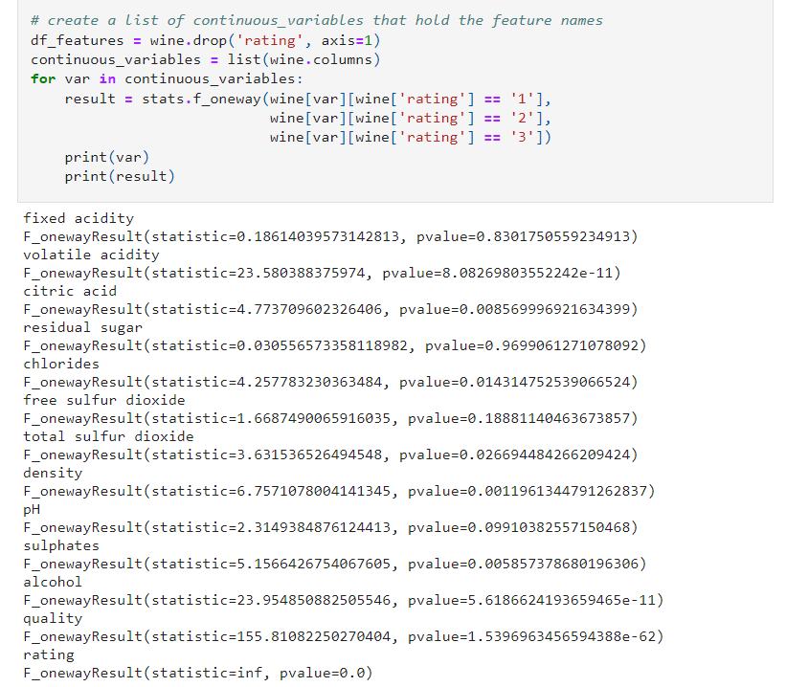
Test for statistical significance of each feature
Features that are statistically significant to predicting the quality rating of our wine are those that have a p-value of <= 0.05. As we can see not all features are statistically significant to predicting the rating of the wine. Let's keep them all for now and see the results of our model. If the model predicts with > 95% accuracy I see no harm in keeping all the features as input parameters for our final output model.

Slide 15
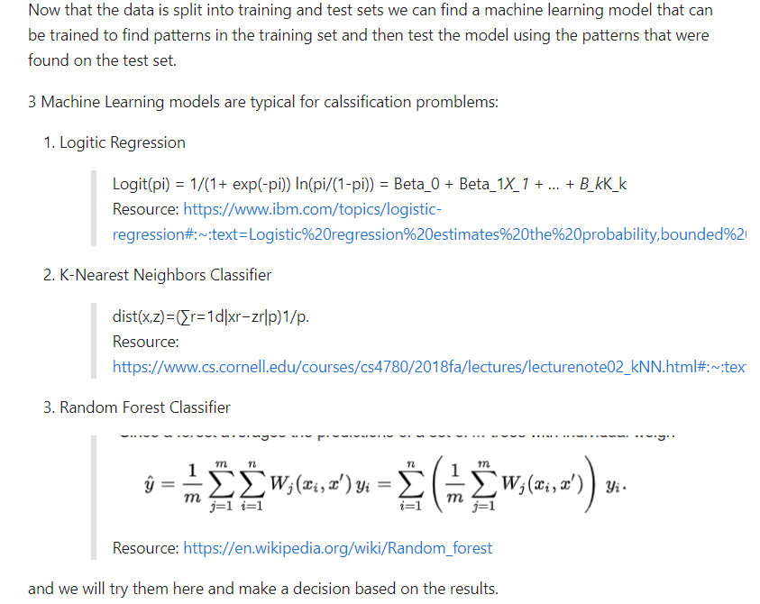
Build a production ready model

Slide 16
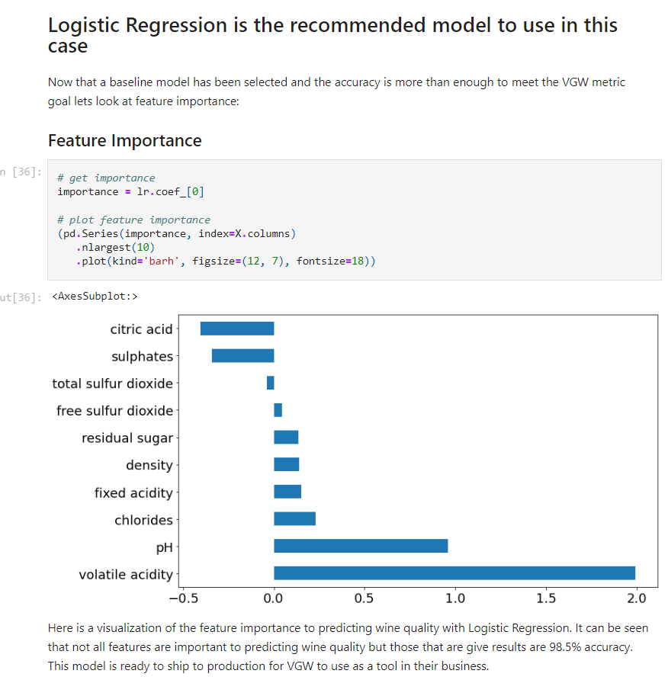
Select a model and look at feature importance

Slide 17
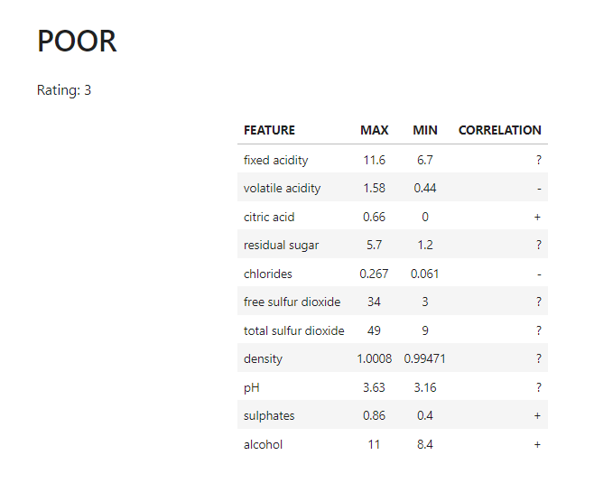
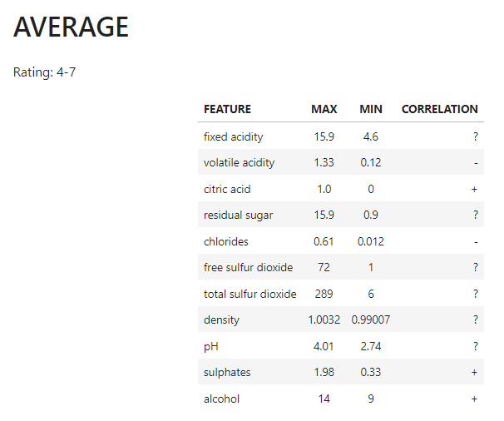
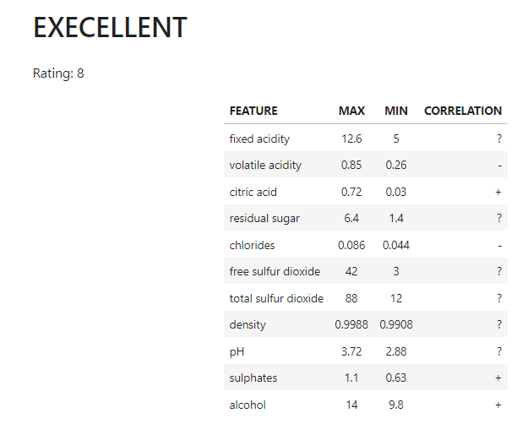
Save and test the model The above values in the charts are the values that will be used as parameters for the inputs form the end user in the web application.

Slide 18
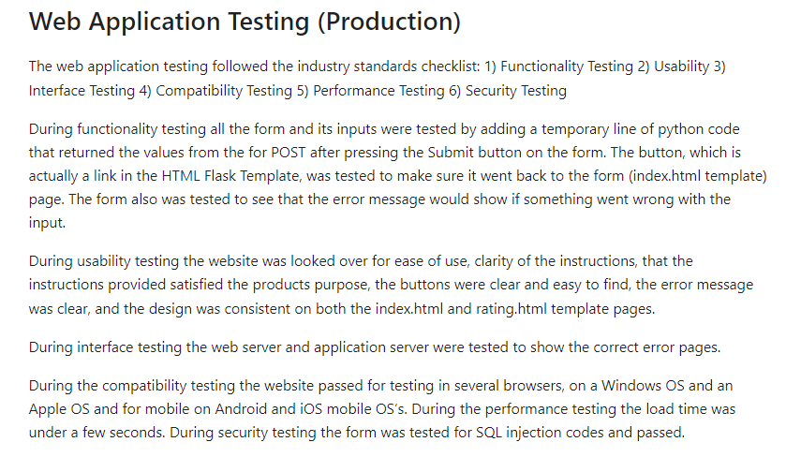
Save and test the model

Slide 19
Outline of the findings

Slide 20
Findings
The research question: "Can the quality of wine be accurately predicted for three categories of poor, average, and excellent?" can be answered from the data analysis as: VGW can predict the quality rating of wine with over 98% accuracy to help better label and sell their wine to consumers.
The web application can be accessed at this link: https://wine-quality-classifier.herokuapp.com/

Slide 21
limitations
of the techniques and tools used

Slide 22
Limitations of techniques used
Techniques for feature selection were used but because the classifiers performed with high accuracy all features were kept and backward feature or similar was not necessary. In the future during maintenance it will be necessary to use the ANOVA method provided in this notebook to test for statistical significance of each feature and drop features whose p-value is >= 0.05%.
Techniques for selecting the best model can remain the same but in the future during maintenance and with more data another model might perform better than Logistic Regression and the saved model for production would need to be updated accordingly.
All the techniques in this notebook from EDA to Testing the final model should be reassessed and improved upon over time.

Slide 23
Limitations of Tools Used
One potential limitation of the tools used are the machine learning classifier algorithms that were selected for building the classifier. Logistic regression, K-Nearest Neighbor, and Random Forest classifiers are common machine learning algorithms to start with when deciding which is best to use. As the company's data grows or if the company gets fresher data the algorithms will start to run slow and might not be the best solution for the problem. The model will need to be maintained and monitored over time as new data becomes available. With more data it would be interested and useful to look at other classifier algorithms such as
Naive Bayes - Naive Bayes applies the Bayes' theorem to calculate the probability of a data point belonging to a particular class.
Ensemble Learning - Ensemble learning is where multiple machine learning models are used to achieve better accuracy than one it's own.

Slide 24
Summary of Proposed actions

Slide 25
Summary of proposed actions
The first deliverable, the Jupyter Notebook, will benefit VGW in several ways. First, it will provide a data analysis and visualization that will be used to better understand what data points about the wine are important for classification allowing VGW employees to use scientific tools to test the wine for quality (such as pH strips and alcohol content detection). Second, the Jupyter Notebook will include three groups of ranged parameters that classify wine into poor, average, and excellent to be used for pricing the wine more accurately. VGW is at risk of losing profits of incorrectly priced wine and losing customers due to high variance in the quality of wine they expect to consume.
The second deliverable, the web application, will provide a user interface that will take input from an employee and return a quality rating of poor, average, or excellent. The benefits of the application are the ability to more efficiently and effectively price wines. With a more consistent pricing model VGW will increase profits and customer retention.

Slide 26
Expected benefits

Slide 27
Expected benefits of the study
VGW can predict the quality rating of wine with over 98% accuracy to help better label and sell their wine to consumers. The expectation is that this study will enable VGW to increase their revenue by 15% over the next year by increasing trust in their brand and prevention of mislabeled excellent quality wines selling for the price of average or poor quality wines.

Slide 28
THANK YOU
Vera Butler
vbutle5@wgu.edu

